Slide 1
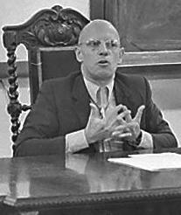
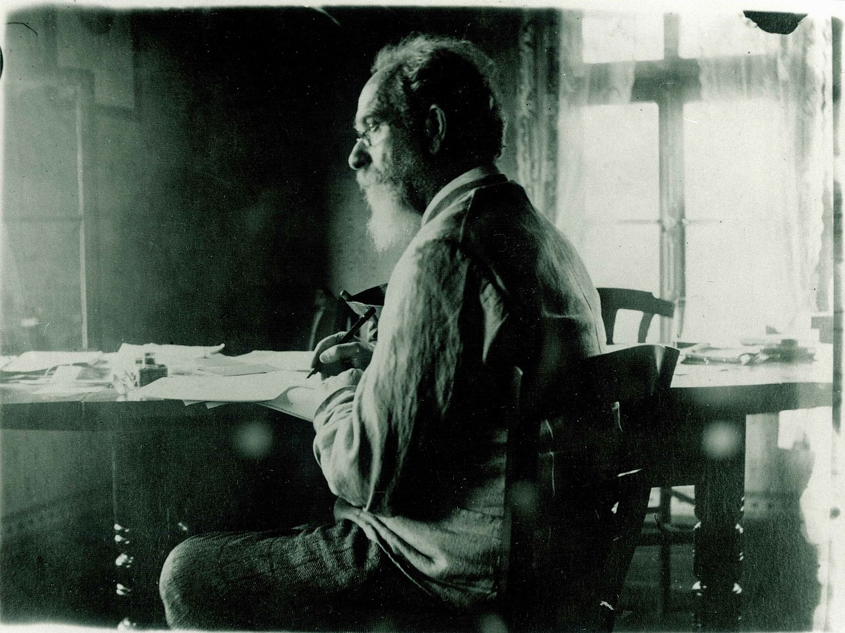
Critique in Husserl And Foucault
The Power of the Reduction …
A Reduction of Power ?
Maren Wehrle: wehrle@esphil.eur.nl

Slide 2
Pregiven Lifeworld
Let us recall the fact that science is a human spiritual accomplishment which presupposes as its point of departure, both historically and for each new student, the intuitive surrounding world of life, pregiven as existing for all in common (…)
When science poses and answers questions, these are questions resting upon the ground of, and addressed to, the elements of this pregiven world in which science and every other life-praxis is engaged.
(Husserl, Crisis, § 33, 121)
Pregiven Discourse
Thus conceived, discourse is not the majestically unfolding manifestation of a thinking, knowing, speaking subject, but, on the contrary, a totality, in which the dispersion of the subject and his discontinuity with himself may be determined.
(Foucault, Archeology of Knowledge, 60)

Slide 3
A Common Critical Spirit
Husserl’s universal critique
Objectivity (transcendental method)
Generality (eidetic method)
Critique as Praxis = Ethos
Foucault’s historical critique (relativity, discontinuity)
Archeology (Positivism / eidetic variation)
Genealogy (Historical A priori/Transcendental)
Critique as Praxis = Ethos
Both attack naïve objectivism, aim at break with self-evidence, and understand critique as praxis/ethos

Slide 4
Conditions of Objectivity
What characterizes objectivism is that it moves upon the ground of the world which is pregiven, taken for granted through experience, seeks the "objective truth" of this world, seeks what, in this world, is unconditionally valid for every rational being at it is in itself (…)
Transcendentalism, on the other hand, says: the ontic meaning [Seinssinn] of the pregiven life-world is a subjective structure [Gebilde], it is the achievement of experiencing, pre-scientific life. (Crisis, 68f.)
Archaeology tries to define not the thoughts, representations, images, themes, preoccupations that are concealed or revealed in discourses; but those discourses themselves, those discourses as practices obeying certain rules (155)
(…) determine the specific rules in accordance with which its objects, statements, concepts, and theoretical options have been formed: if there really is a unity (…) it resides (…) in the system that makes possible and governs that formation
(Foucault, Archeology of Knowledge, 80)

Slide 5
Critique as Ethos
Wir erinnern uns an den Radikalismus der Cartesianischen Idee der Philosophie als der der universalen, bis ins letzte apodiktisch begründeten Wissenschaft. Als solche fordert sie eine absolute universale Kritik, die sich ihrerseits zunächst durch Enthaltung von allen irgendein Seiendes vorgebenden Stellungnahmen ein Universum absoluter Vorurteilslosigkeit schaffen muß. (Hua, I, 74)
[T]he thread which may connect us with the Enlightenment is not faithfulness to doctrinal elements but rather the permanent reactivation of an attitude—i.e. a philosophical ethos that could be characterised as a permanent critique of our historical being’ (Foucault, EW1, 312)

Slide 6
Common Methods and Assumptions
Husserl’s and Foucault’s Eidetic Variation
Texts as examples of (in)variance within/between time periods
Categorial Essences and formal rules of discourses
Husserl’s and Foucault’s Transcendentalism
transcendental ego → transcendental embodied person→ History
Historical A priori
Order as transcendental condition (discourse/experience)

Slide 7
Reduction of Power?
Aim = Objectivity (for all) vs. Power (for a few)
To the things themselves (adequate perception/differentiation)
To be able to perceive/think differently
presupposes the bracketing of self-evidence
Endless, collective task: combining a plurality of different perspectives

